Slide 1
E-COMMERCE CUSTOMER SEGMENTATION AND PREDICTION

Slide 2

INTRODUCTION :
DEFINITION OF CUSTOMER SEGMENTATION:
IT IS A PROCESS OF DIVIDING A CUSTOMER BASE INTO GROUPS BASED ON SHARED CHARACTERISTICS SUCH AS BEHAVIOURS AND PREFERENCES. THIS ALLOWS BUSINESSES TO TAILOR MARKETING STRATEGIES AND OFFERS TO MEET THE SPECIFIC NEEDS AND DESIRES OF EACH SEGMENT ENHANCING CUSTOMER SATISFACTION AND ENGAGEMENT
IMPORTANCE OF CUSTOMER SEGMENTATION
IT HELPS BUSINESSES TARGET THEIR MARKETING AND PRODUCTS MORE EFFECTIVELY BY GROUPING CUSTOMERS BASED ON THEIR PREFERENCES AND BEHAVIORS. THIS LEADS TO: MORE RELEVANT OFFERS HIGHER ENGAGEMENT BETTER CUSTOMER SATISFACTION

Slide 3
CONDUCT ANALYSIS TO UNDERSTAND
CUSTOMER BEHAVIOUR AND THEIR PURCHASING PATTERNS.
COMPARE THE PERFORMANCE OF MULTIPLE SEGMENTATION ALGORITHMS.

Slide 4
SEGMENTATION METHODS AND TECHNIQUES USED
METHODS APPLICABLE FOR ANALYZING DIFFERENT CUSTOMER ATTRIBUTES
TRADITIONAL METHODS :
RECENCY | FREQUENCY | MONETARY VALUE = ( RFM ) ( FEATURE ENGINEERING )
(R) - IT SIMPLY MEANS - DAYS SINCE THE LAST PURCHASE
(F) - REFERS TO NUMBER OF PURCHASES ( INVOICES PER CUSTOMER )
(M) - IS THE TOTAL AMOUNT SPENT BY CUSTOMERS
ADVANCED METHODS :
USED TO IDENTIFY THE MOST EFFECTIVE ( CUSTOMER SEGMENTS)
K-MEANS CLUSTERING - DIVIDES DATA INTO A PREDEFINED NUMBER OF CLUSTERS BY MINIMIZING THE VARIANCE WITHIN EACH CLUSTER, USING THE MEAN OF THE POINTS IN EACH CLUSTER AS THE CENTROID.
HIERARCHICAL CLUSTERING - BUILDS A TREE OF CLUSTERS BY EITHER MERGING SMALLER CLUSTERS OR SPLITTING LARGER CLUSTERS , PRODUCING A DENDROGRAM TO VISUALIZE THE CLUSTERING HIERARCHY.
DBSCAN (DENSITY-BASED SPATIAL CLUSTERING APPLICATION WITH NOISE) IDENTIFIES CLUSTERS BASED ON THE DENSITY OF DATA POINTS, GROUPING POINTS THAT ARE CLOSE TO EACH OTHER WHILE MARKING POINTS IN LOW-DENSITY REGIONS AS NOISE.

Slide 5
EXPLORATORY DATA ANALYSIS
PLOTS ARE BEEN CREATED FOR ( RFM ) DISTRIBUTION
FOR SHOWING THE CORRELATION BETWEEN THE ( RFM ) VARIABLES A CORRELATION HEATMAP IS ALSO GENERATED
DATA LOADING AND PREPROCESSING
NECESSARY LIBRARIES ARE IMPORTED FROM THE DATA 'data.csv’.
BASIC INFORMATION ABOUT THE DATASET IS DISPLAYED USING df.info() and df.describe().
MISSING VALUES ARE CHECKED USING df.isnull().sum().
'INVOICEDATE' IS CONVERTED TO DATETIME FORMAT FOR TIME-BASED ANALYSIS.
‘TOTAL AMOUNT' IS CALCULATED BY MULTIPLYING 'QUANTITY' AND ‘UNIT PRICE’.

Slide 6
PREDICTIVE MODEL
A ( RANDOM FOREST CLASSIFIER ) IS TRAINED TO PREDICT THE CUSTOMER SEGMENTS
THE DATA IS SPLIT INTO TRAINING AND TESTING SETS
WHERE = TRAIN SETS ARE 80% TEST SETS ARE 20%
MODEL EVALUATION
TO EVALUATE MODEL’S PERFORMANCE
USED =
CLASSIFICATION REPORT
CONFUSION MATRIX IS VISUALIZED

Slide 7
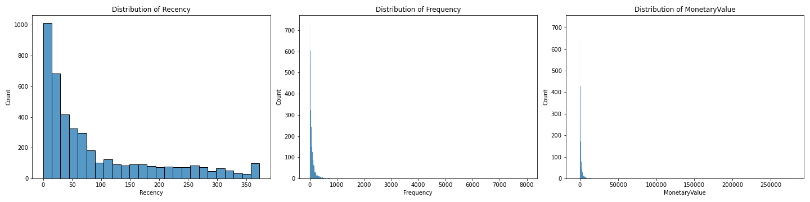
RFM_DISTRIBUTIONS.PNG:

Slide 8
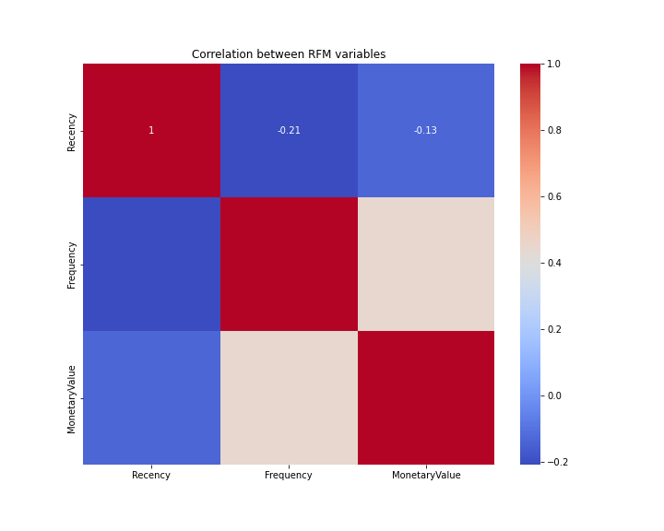
RFM_CORRELATION.PNG:

Slide 9
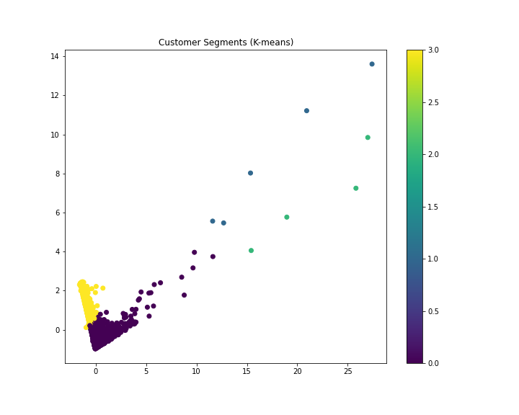
KMEANS_CLUSTERS.PNG:

Slide 10
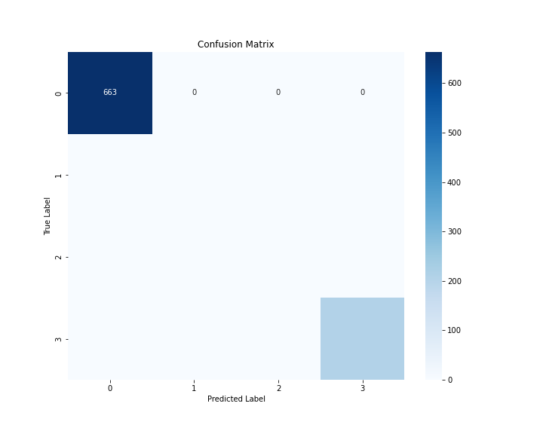
CONFUSION_MATRIX.PNG:

Slide 11
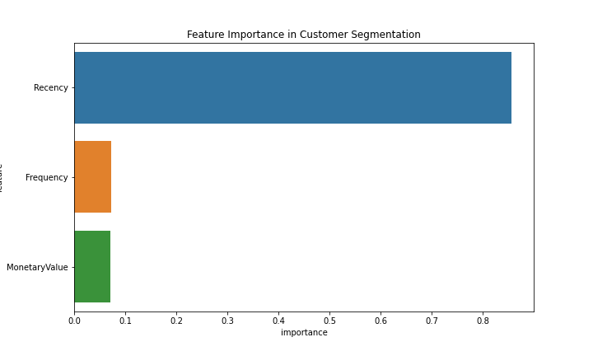
FEATURE_IMPORTANCE.PNG:

Slide 12
GRAPHS AND MATRICES EXPLANATION
rfm_distributions.png:
This image shows three histograms representing the distribution of Recency, Frequency, and Monetary Value across customers.
rfm_correlation.png:
This heatmap shows the correlation between RFM variables
kmeans_clusters.png:
This scatter plot shows the customer segments by K-means clustering
confusion_matrix.png:
This heatmap showcases the performance of the Random Forest classifier in predicting customer segments. The diagonal line shows correct predictions and the off-diagonal shows misclassifications.
feature_importance.png:
This bar plot shows the importance of each RFM feature in the Random Forest model for predicting customer segments.
THIS OVERALL ANALYSIS CAN HELP IN UNDERSTANDING
CUSTOMER BEHAVIOUR IDENTIFYING VALUABLE CUSTOMER SEGMENTS DEVELOPING TARGETED MARKETING STRATEGIES

Slide 13
Thank You!

